Slide 1

VIRTUAL INTELLIGENCE SERVICE
VICTORIA PER INTELLECTUM
SYRIAN AIRFORCE
INTREP VIS-OPAR-003
DRAFT
DISCLAIMER:
This is for multiplayer online gaming using the Digital Combat Systems simulation software published by Eagle Dynamics. The information is not in any way suitable for real world use or operations.
Version: X.X
Published: YYYY-MM-DD

Slide 2
INTRODUCTION
A
A
Aim:
This report intends to present information on the Syrian Airforce, Squadron locations and information about their capability.
Reference:
- INTREP VIS B-002 Generic Air Force Structure v1.0
- INTREP VIS OPAR-002 - Syrian IADS
Content:
Doctrine
Command and Control
Other critical targets
Mission type capability
Organization
Squadron locations
B
B
C
C
D
D
E
E
F
F

Slide 3
Doctrine
Air operations: General
The Syrian Air Force have two primary objectives:
Defend Syrian territory
Project power to Syrian enemies
Syrian Air Force have a more centralized command and control than coalition airforces. This means that Syrian air operations are more scheduled and will come in waves. The Syrian forces are not trained and have a level high enough for conducting decentralized COMAO (Combined Air Operations = package operations)
Once a aircraft is airborne it is not beeing controlled in air, and will execute its mission as briefed. The only exception is fighters and interceptors beeing controlled from GCI as part of the Syrian IADS.
In the case of a major Syrian air operation, expect A-A sweep to be sent in first, followed by A-G aircraft doing strikes. 701st and 702nd Fighter Squadrons are the only squadron with a limited capability to conduct escort missions for A-G flights.
Air operations: A-G
Syrian Air Force has a very limited if not absent inter-agency coordination between the Air Force and ground forces. Ground forces have limited means to cooperate with the Air Force, and different Districts cannot operate together on high tempo operations. This is due to organization design, command structures, lack of specific training and focus for the ground forces.
For major ground offensives assault aviation squadrons will contribute to shaping the battlefied prior to the start of the Syrian ground attack. Once the Syrian ground attack is moving forward, the assault aviation squadrons will not conduct CAS operations. Assault aviation squadrons will then be used further ahead from the attack in a AR role, or keeping the enemy busy by attacking elsewhere.
Air operations: A-A / Air Defense
The Syrian Air Force’s most important objective is to defend the Syrian territory and because of this part of the Syrian Air Force is tied into the Syrian Integrated Air Defense System (IADS). All interceptor squadrons are tied directly to the Air Defense, while the Fighter Squadrons rotate in taking turns flying DCA missions in various parts of Syrian to ensure a high readiness of fighter aircrafts to support against any aggression toward Syrian territory.
DCA CAP operations is normally forward staged as part of the layered defense where CAP is first line of defense, second line of defense is interceptors beeing scrambled from airbases and the third line of defense is the IADS network.
A
A
B
B
C
C
D
D
E
E
F
F
Back

Slide 4
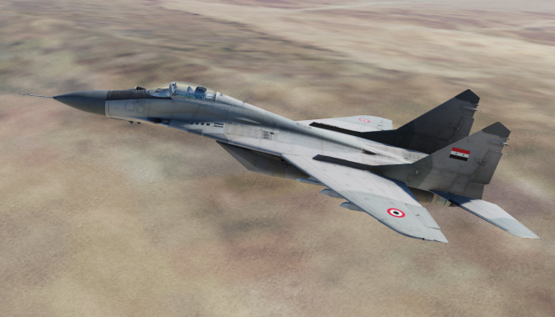
Command and Control
Syrian Air Force Headquarter
- Work with long term plans, training, budgeting and will have no effect on the short term.
- If destroyed will reduce ability to train new pilots, introduce new aircraft, weapons and systems.
Air Division Headquarter
Plans and execute major Syrian air operations.
If destroyed, the squadrons belonging to that division will not be able to participate in major air operations until a new division headquarter is operational .
Regiment Headquarter
Plans and execute the missions for the squadrons in the Regiment on the short term.
If destroyed, it will reduce the squadrons ability to schedule missions, and thus lower amount of sorties will be available from the squadron.
Ground Controlled Intercept Station (GCI Station)
Supports the Syrian Air Defense with control of fighters and interceptors conducting DCA operations.
If destroyed:
- May prevent scrambles of intercept aircraft
May lead to intercept aircraft flying to wrong areas
May lead to lower quality of flying from intercept aircraft due to lack of GCI support
A
A
B
B
C
C
D
D
E
E
F
F
Back

Slide 5
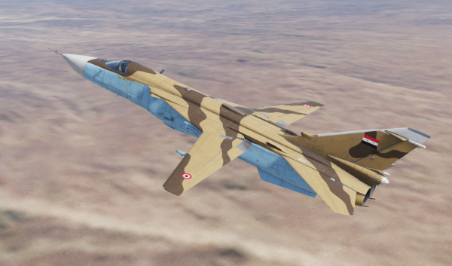
Other critical targets
Airfields:
Runways:
Airfield out of operation for 24-48 hours
Depending on the amount of damage inflicted
Ammunition storage:
Certain types of ammunition unavailable
Sortie rates reduced
Depending on the amount of damage inflicted
Fuel:
Sortie rates reduced until able to resupply
Depending on the amount of damage inflicted
Maintenance:
- Squadron readiness reduced to low readiness due to reduced ability to conduct maintenance
Aircrafts
- Destruction of aircraft will reduced the capability of the squadron as they have fewer aircraft available
A
A
B
B
C
C
D
D
E
E
F
F
Back

Slide 6
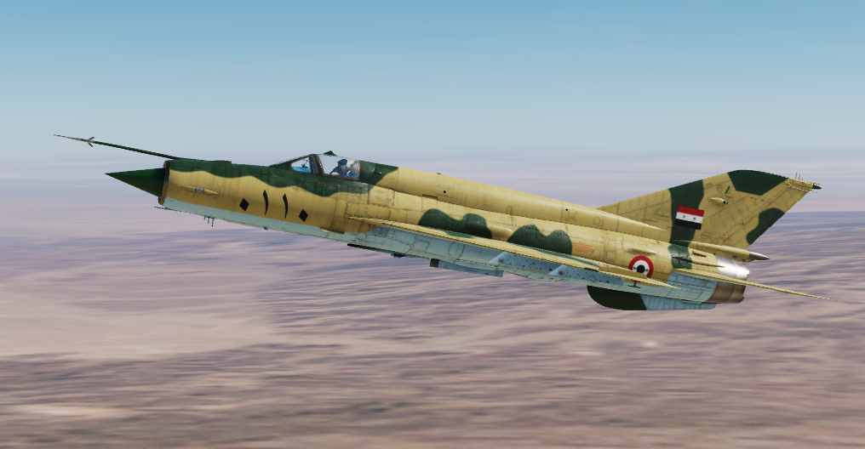
Mission type capability
Fighter squadrons conduct the following mission sets:
- Sweep,
CAP
Limited form of escort.
Interceptor squadrons are based at airfields and tied to Syrian IADS and supports as Quick Reaction Alert flights to protect Syrian airfields from attack.
Assault Aviation squadrons conduct the following mission sets:
CAS (with ground forces in static positions)
AR
AI
Bomber Squadrons conduct the following mission sets:
AI
Strikes
A
A
B
B
C
C
D
D
E
E
F
F
Back

Slide 7
Organization
SYR AF
60th Air Division
A-A role
70th Air Divison
A-G role
80th Support Division
Support role
1st Fighter Aviation Regiment (MiG-29)
2nd Fighter Aviation Regiment (MiG-21)
3rd Interceptor Aviation Regiment (MiG-25)
621st Interceptor Squadron
622nd Interceptor Squadron
611th Fighter Squadron
612th Fighter Squadron
613th Fighter Squadron
601st Fighter Squadron
602nd Fighter Squadron
603rd Fighter Squadron
A
A
B
B
C
C
D
D
E
E
F
F
Back

Slide 8
Organization
SYR AF
60th Air Division
A-A role
70th Air Divison
A-G role
80th Support Division
Support role
1st Fighter Aviation Regiment (MiG-29)
2nd Fighter Aviation Regiment (MiG-21)
3rd Interceptor Aviation Regiment (MiG-25)
621st Interceptor Squadron
622nd Interceptor Squadron
611th Fighter Squadron
612th Fighter Squadron
613th Fighter Squadron
601st Fighter Squadron
602nd Fighter Squadron
603rd Fighter Squadron
N
= Night capable
A
A
Exp
= Experienced
A
= Attack (A-G)
B
B
F/A
= Fighter+Attack
(A-A + A-G)
C
C
D
D
E
E
F
F
Night
Exp
Exp
Night
Exp
Night
Exp
Back

Slide 9
Organization
SYR AF
60th Air Division
A-A role
70th Air Divison
A-G role
80th Support Division
Support role
4th Figher Aviation Regiment (MiG-23)
5th Assault Aviation Regiment (MiG-29)
6th Assault Aviation Regiment (MiG-29)
7th Bomber Regiment (SU-24)
8th Interceptor Regiment (MiG-21)
701st Fighter Squadron
702nd Fighter Squadron
711th Assault Aviation Squadron
712th Assault Aviation Squadron
721st Assault Aviation Squadron
722nd Assault Aviation Squadron
731st Bomber Squadron
732nd Bomber Squadron
741st Interceptor Squadron
742nd Interceptor Squadron
A
A
B
B
C
C
D
D
E
E
F
F
Back

Slide 10
Organization
SYR AF
60th Air Division
A-A role
70th Air Divison
A-G role
80th Support Division
Support role
4th Figher Aviation Regiment (MiG-23)
5th Assault Aviation Regiment (MiG-29)
6th Assault Aviation Regiment (MiG-29)
7th Bomber Regiment (SU-24)
8th Interceptor Regiment (MiG-21)
701st Fighter Squadron
702nd Fighter Squadron
711th Assault Aviation Squadron
712th Assault Aviation Squadron
721st Assault Aviation Squadron
722nd Assault Aviation Squadron
731st Bomber Squadron
732nd Bomber Squadron
741st Interceptor Squadron
742nd Interceptor Squadron
N
= Night capable
A
A
Exp
= Experienced
A
= Attack (A-G)
B
B
F/A
= Fighter+Attack
(A-A + A-G)
C
C
D
D
E
E
F
F
Night
Exp
Night
F/A
Exp
A
Night
Exp
Night
F/A
A
Back

Slide 11
Organization
SYR AF
60th Air Division
A-A role
70th Air Divison
A-G role
80th Support Division
Support role
9th Transport Aviation Regiment
811th Transport Squadron (YAK-40)
801st Transport Squadron (IL76)
802nd Transport Squadron (AN-26B)
A
A
B
B
C
C
D
D
E
E
F
F
Back

Slide 12
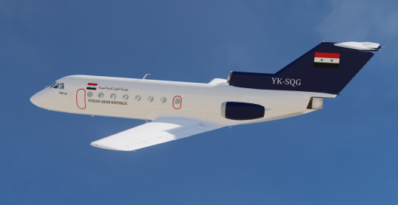
Organization
SYR AF
60th Air Division
A-A role
70th Air Divison
A-G role
80th Support Division
Support role
9th Transport Aviation Regiment
811th Transport Squadron (YAK-40)
801st Transport Squadron (IL76)
802nd Transport Squadron (AN-26B)
N
= Night capable
A
A
Exp
= Experienced
A
= Attack (A-G)
B
B
F/A
= Fighter+Attack
(A-A + A-G)
C
C
D
D
E
E
Exp
F
F
Night
Back

Slide 13
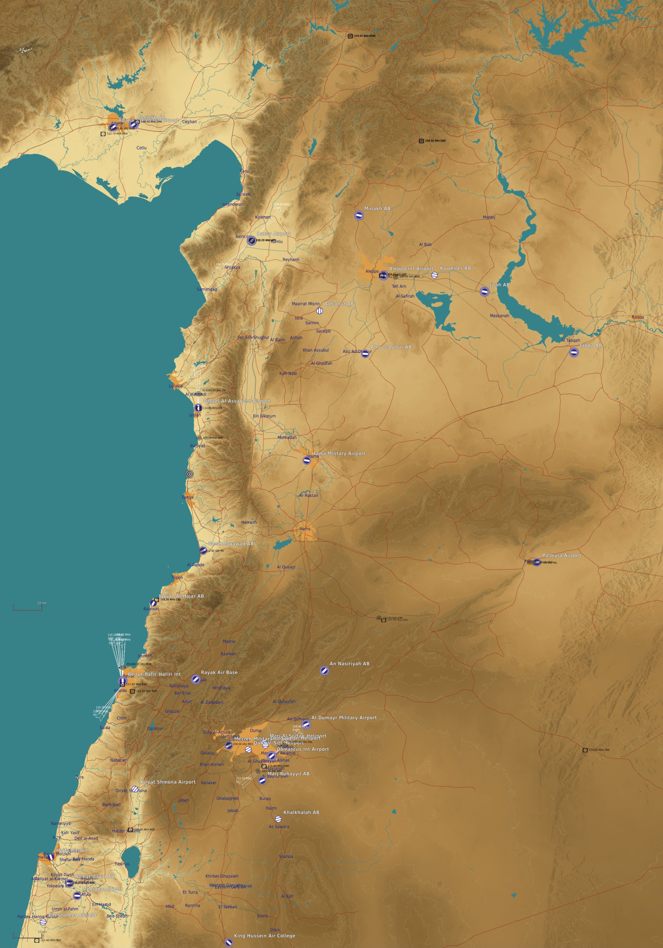
Squadron locations
LEGEND:
MINHAK AB
ALEPPO INTL
KUWEIRES AB
A
A
60th Division (A-A)
TAFTANAZ AB
JIRAB AB
B
B
70th Division (A-G)
ABU UL DUHUR
MiG-29 SQN (601)
MiG-29 SQN (602)
C
C
80th Division (Support)
MiG-21 SQN (613)
IL-76 SQN (801)
D
D
TABQA AB
E
E
BASSEL AL-ASSAD INTL AIRPORT
MiG-25 SQN (621)
MiG-29 SQN (711)
MiG-29 SQN (712)
SU-24 SQN (731)
F
F
HAMA MIL AB
MiG-21 SQN (742)
MiG-23 SQN (701)
MiG-23 SQN (702)
PALMYRA
AN NASIRIYAH AB
MEZZEH MIL
MiG-29 SQN (721)
MiG-29 SQN (722)
MiG-25 SQN (622)
AL DUMARY MIL
MARJ RUHAYL
MiG-21 SQN (741)
MiG-21 SQN (611)
MiG-21 SQN (612)
AN-26B SQN (802)
KHALKHALAH AB
YAK-40 SQN (811)
MiG-29 SQN (603)
Back
SU-24 SQN (732)

Slide 14
INTELLIGENCE GAPS
Provide a list of questions or gaps in intelligence, where taskings can be generated to collect information
INSERT MAP HERE
A
A
B
B
C
C
D
D
E
E
F
F
Back

